Slide 1

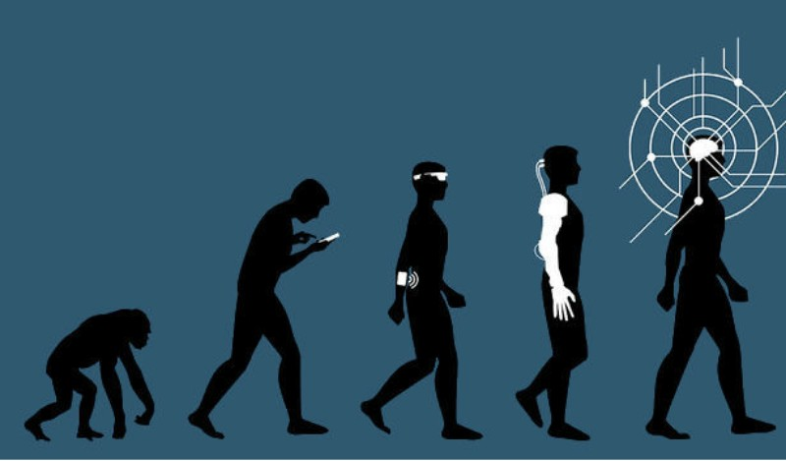

Depth refinement using content aware neural network filters
Shai Weisman
Under the supervision:
Mr. Shay Elmalem
Dr. Raja Giryes
Gaussian filter (???)
bilateral filter
(1998)
Joint filter
(2004)
Joint filter Net
(2017)
Deformable Kernel network
(2019)
SOTA

Slide 2
Executive Summary
The focus of the research
Depth refinement by using deep learning content aware filters
Approach
Examine the current SOTA DNN architecture
Test the use of smooth activation function (ELU) instead of RELU
Compare the use of L1 loss function to Adaptive loss fuction
Results
Reduce error to 80% on simulated validation set
Couldn’t bridge domain gap between simulated data to real world

Slide 3
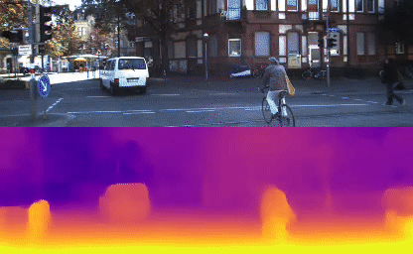
Depth images
Advantages
Allows Dense representation of the scene
Gives intuition about occlusion and free space
Depth discontinuities are just edges on the image
Challenges
Texture less regions
Repetitive areas (especially in stereo)
Unclear object edges
Example of RGB images and matching Depth images
Notes:
https://arxiv.org/pdf/1811.06152.pdf

Slide 4

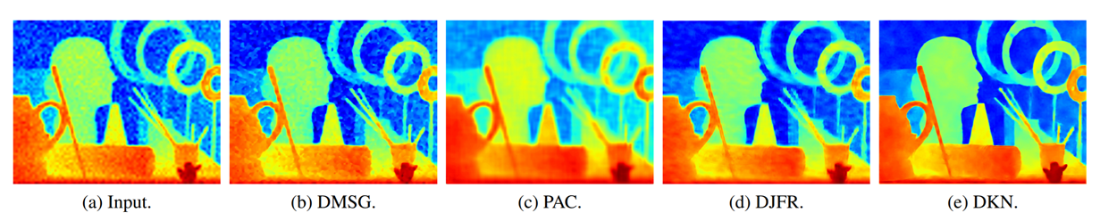
Main concept
Refinement Block
RGB image
Refined image
Depth image
Notes:
https://arxiv.org/pdf/1811.06152.pdf

Slide 5
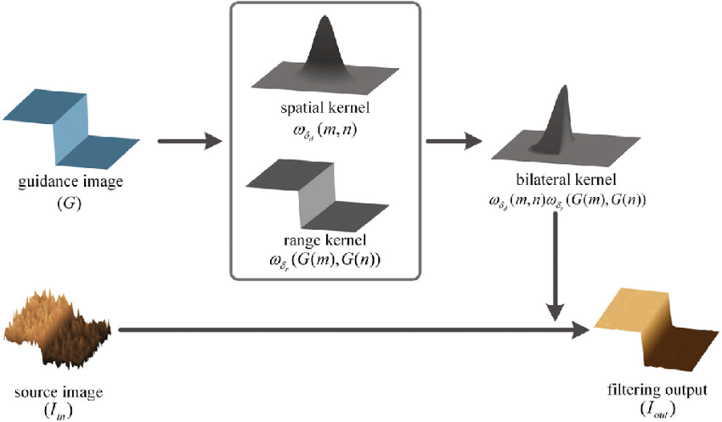
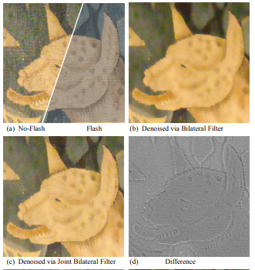
Refinement block- joint bilateral filter(2004)
$$\tilde{I}\left(x\right)=\frac{1}{\sum_{\left.y∈N(x\right)}{e^{\frac{−{\left\|y−x\right\|}^{2}}{2σ_{d}^{2}}}e^{\frac{−{\left\|\left.I_{G}\left(x\right)−I_{G}(y\right)\right\|}^{2}}{2σ_{r}^{2}}}}}\sum_{\left.y∈N(x\right)}{I(y)e^{\frac{−{\left\|y−x\right\|}^{2}}{2σ_{d}^{2}}}e^{\frac{−{\left\|\left.I_{G}(x)−I_{G}(y\right)\right\|}^{2}}{2σ_{r}^{2}}}}$$
Notes:
https://arxiv.org/pdf/1811.06152.pdf

Slide 6
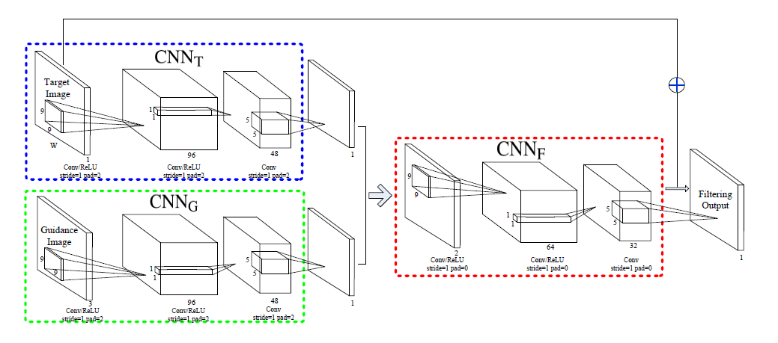
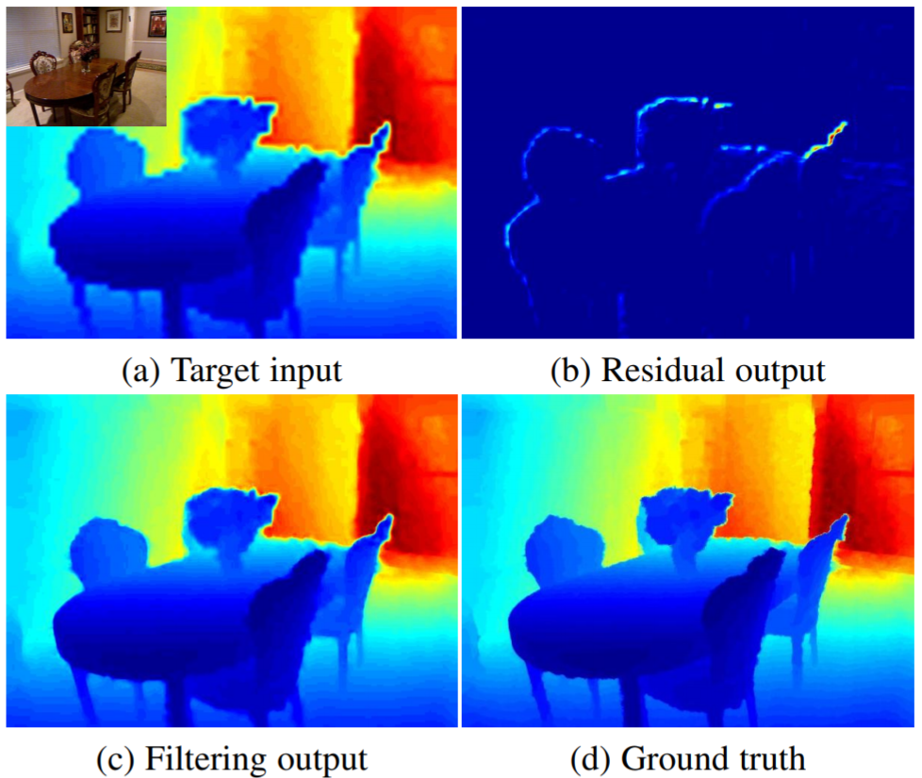
Refinement block-JF-Net(2017)
Feature Extraction of Guide and Target IMAGE
Mapping the features for desired residuals
Li, Yijun, et al. "Joint image filtering with deep convolutional networks.“, IEEE transactions on pattern analysis and machine intelligence 41.8 (2019): 1909-1923
Notes:
https://arxiv.org/pdf/1811.06152.pdf

Slide 7
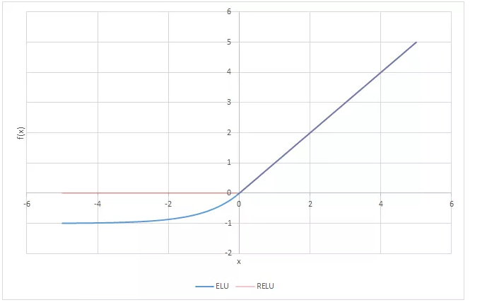
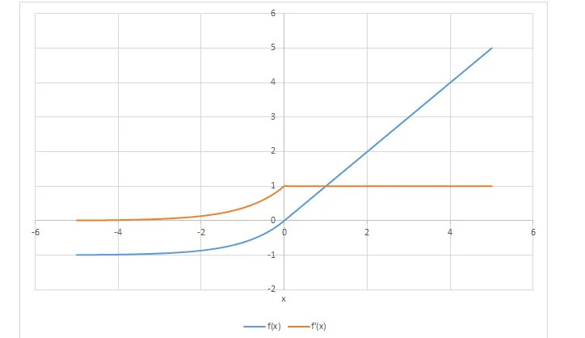
ELU vs RELU
$$ELU \left(x\right)=\left\{\begin{aligned}&x if x>0 \\ &α\left(e^{x}−1\right) if x<0\end{aligned}\right. ELU^{′}\left(x\right)=\left\{\begin{aligned}&1 if x>0 \\ &ELU\left(x\right)+α if x<0\end{aligned}\right.$$

Slide 8
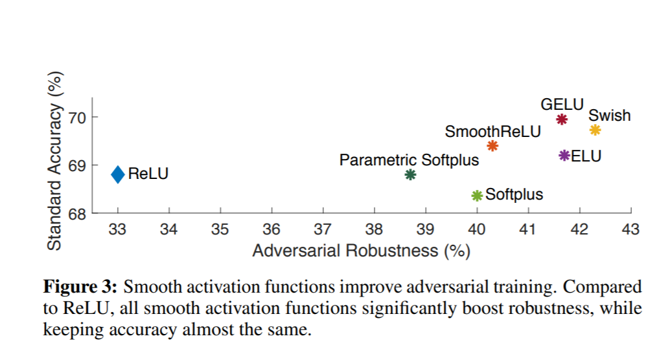
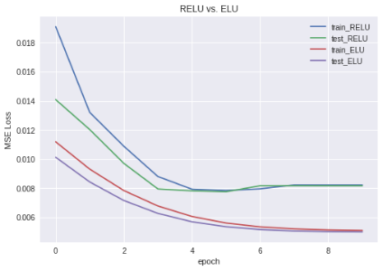
ELU vs RELU
Xie C, Tan M, Gong B, Yuille A, Le QV. Smooth Adversarial Training. arXiv preprint arXiv:2006.14536. 2020 Jun 25.

Slide 9
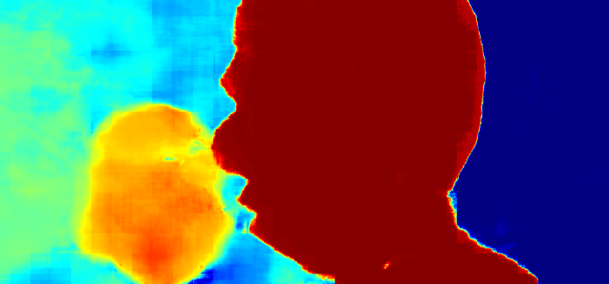
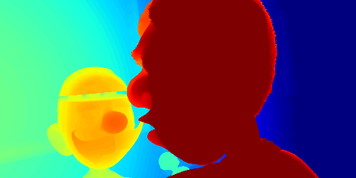

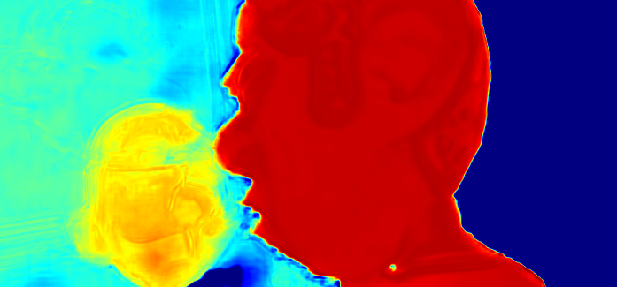
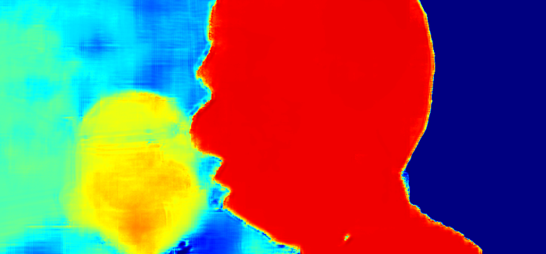
Initial Results
Method | L1 loss per image | L1 loss per pxl | output_loss/ input_loss
input | 2008442 | 4.670 | 1
JF_ReluL1 | 5460072 | 12.695 | 2.72
JF_ELU_L1 | 3005474 | 6.988 | 1.50
Input
GT
RELU Output
ELU Output

Slide 10
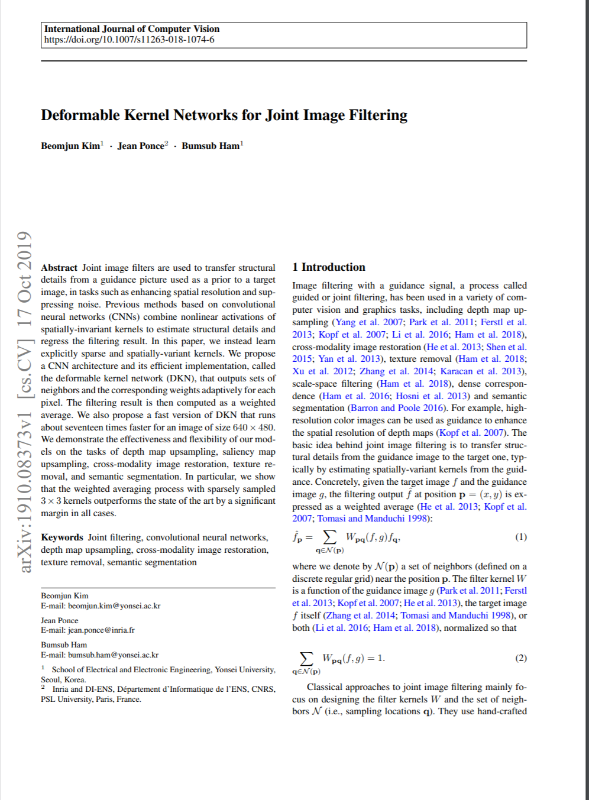
Deformable Kernel Networks (DKN)
novel variation to classical guided weighted averaging process for joint image filtering and its implementation, the DKN, that computes the set of neighbors and their corresponding weights adaptively for individual pixels
New approach to joint filtering (published Oct’ 2019)
Decrease error by 30 to 50% wo loss of speed
Fast DKN (0.6M params vs 1.1M) is 17x faster, with small loss to accuracy.

Slide 11
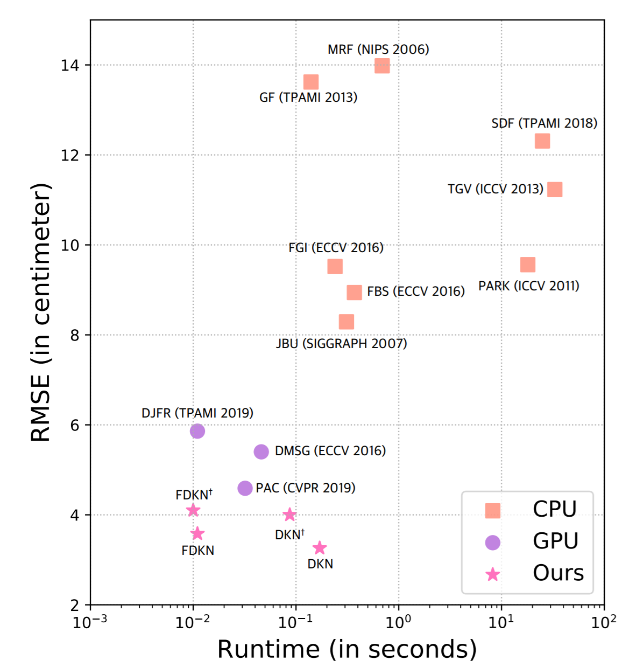
Deformable Kernel Networks (DKN)
novel variation to classical guided weighted averaging process for joint image filtering and its implementation, the DKN, that computes the set of neighbors and their corresponding weights adaptively for individual pixels
New approach to joint filtering (published Oct’ 2019)
Decrease error by 30 to 50% wo loss of speed
Fast DKN (0.6M params vs 1.1M) is 17x faster, with small loss to accuracy.

Slide 12
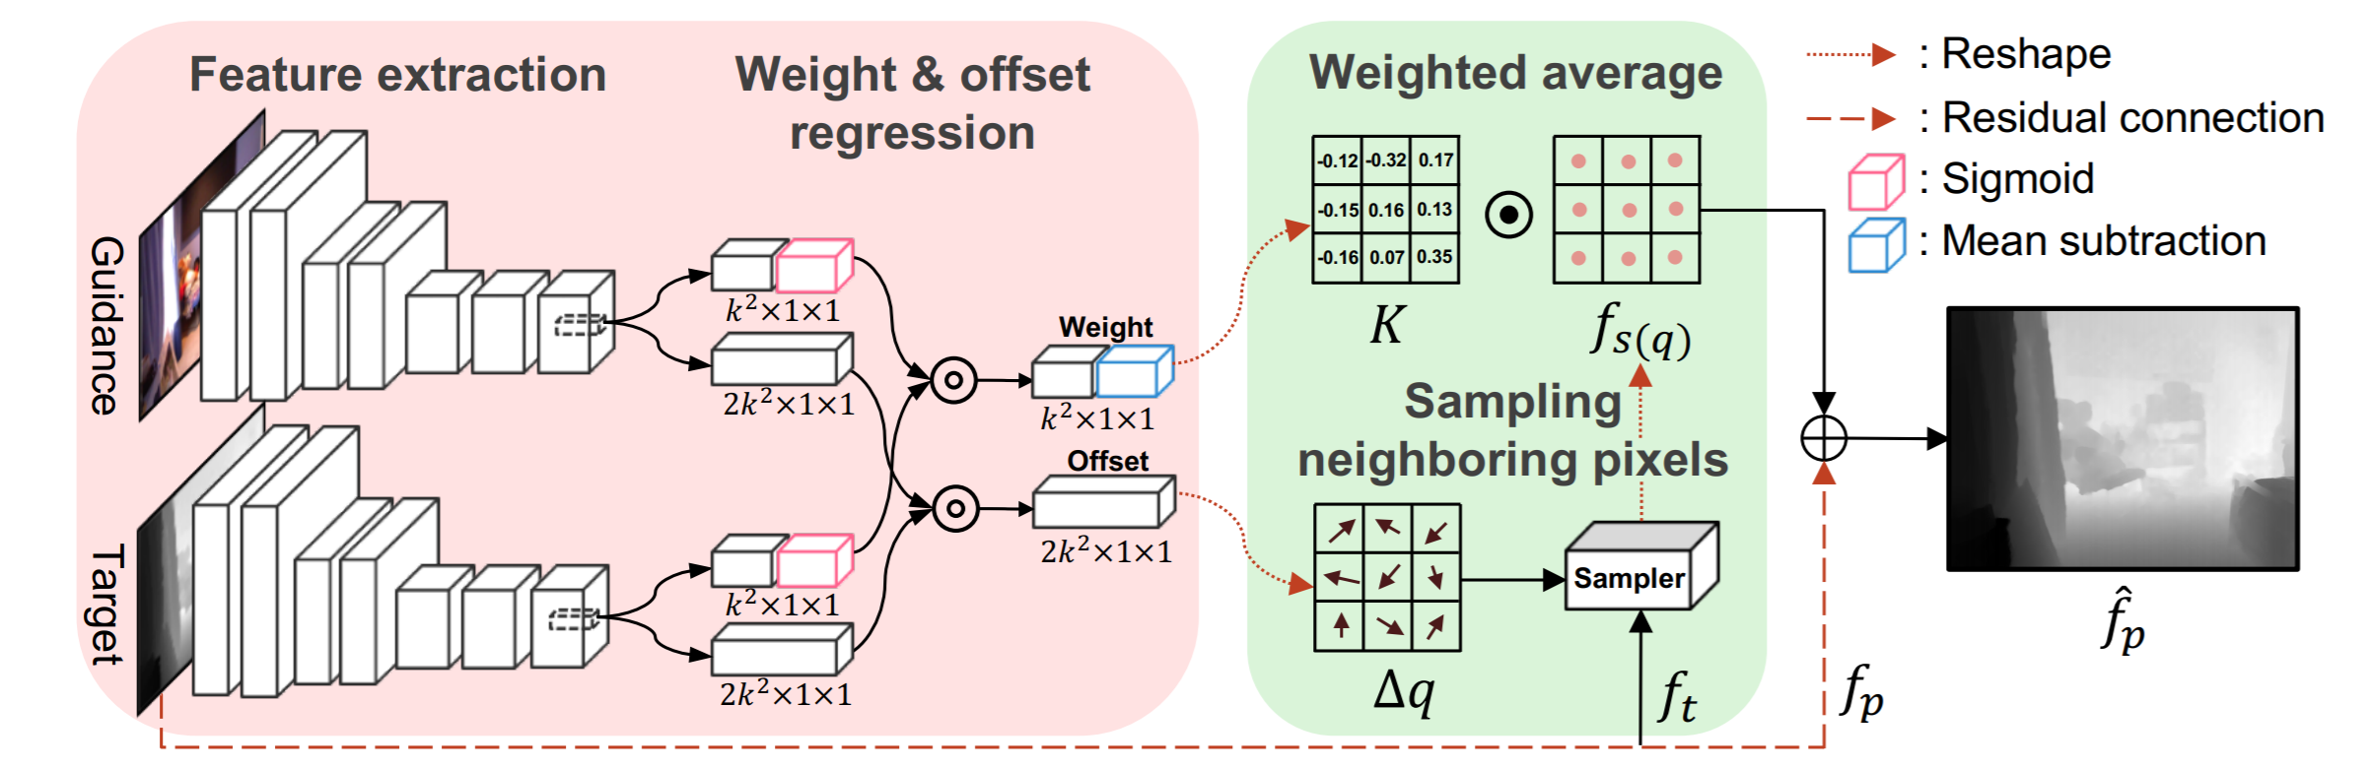
DKN

Slide 13
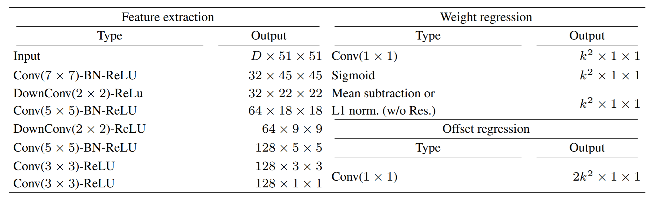
DKN
K-size of kernel
-element wise multiplication

Slide 14
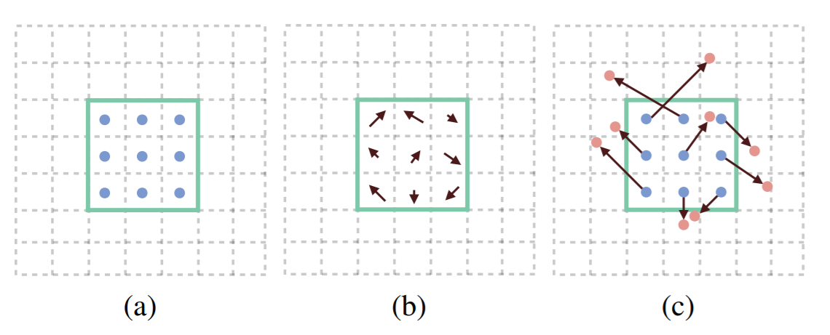
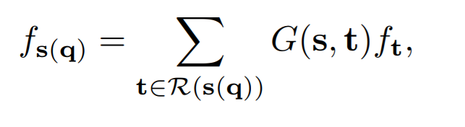
DKN
=
Deformable Weighted Kernel

Slide 15
DKN

Slide 16
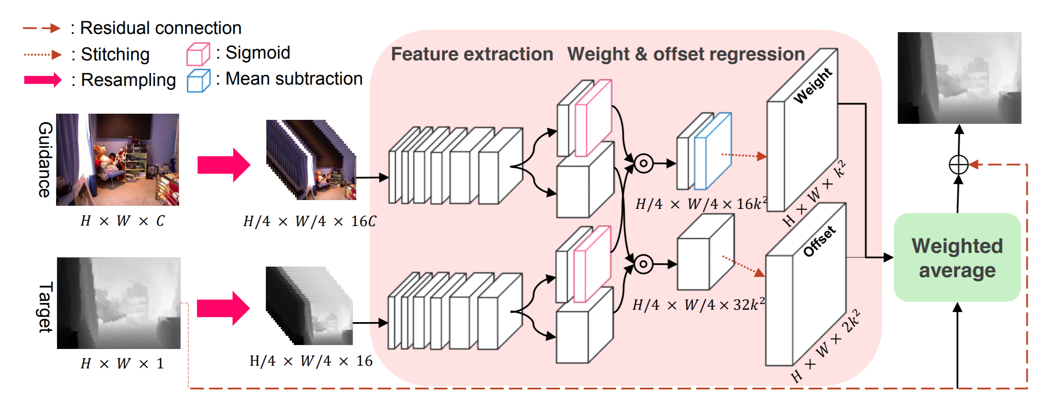
F(ast)DKN

Slide 17
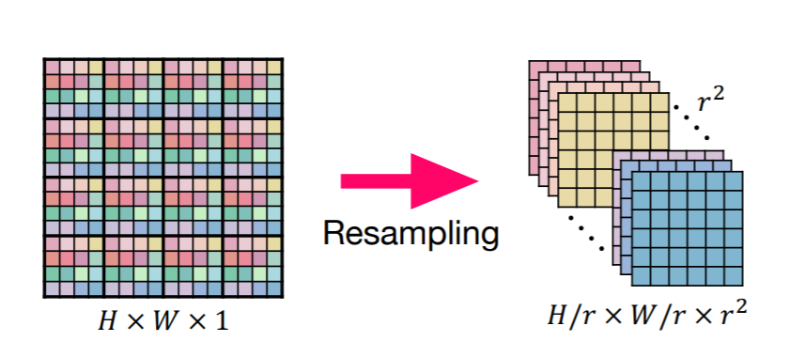
FDKN

Slide 18
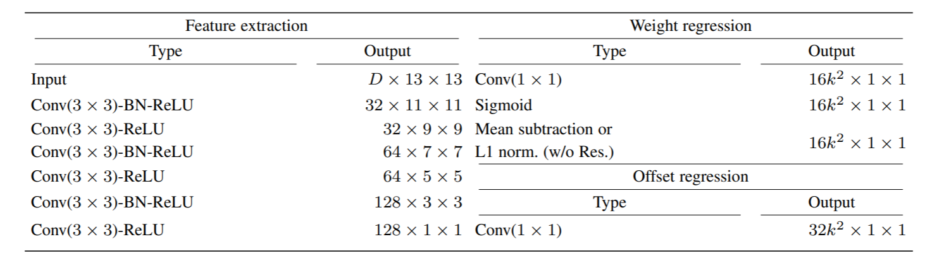
FDKN

Slide 19
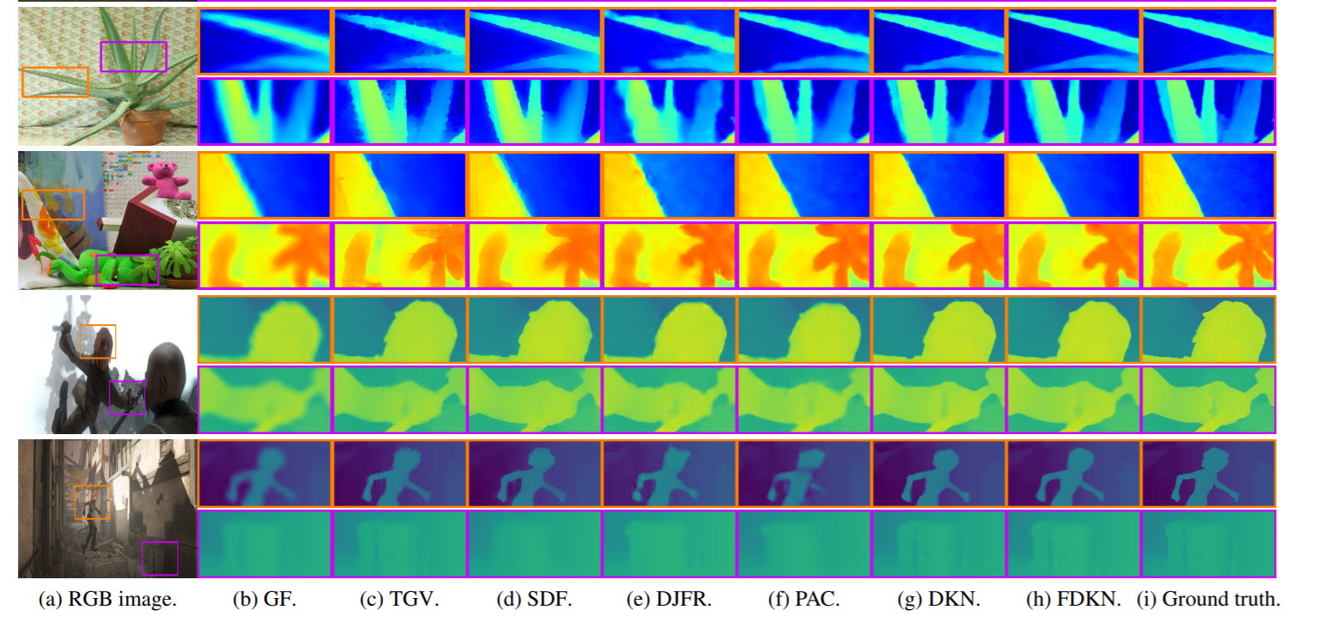
Results from DKN Paper

Slide 20
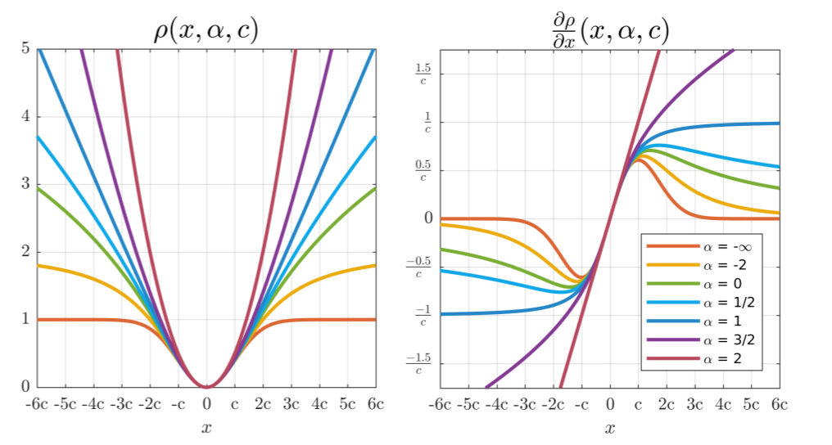
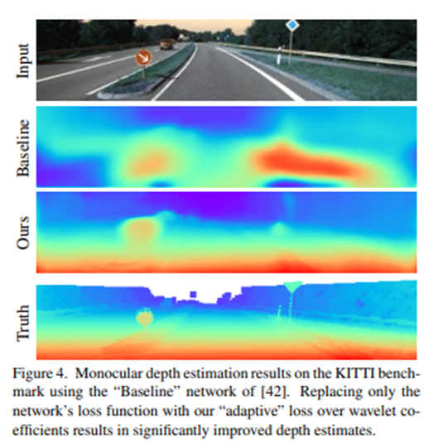

Adaptive loss function
$$f\left(x,α\right)=\frac{\left|α−2\right|}{α}\left({\left(\frac{x^{2}}{\left|α−2\right|}\right)}^{\frac{α}{2}}−1\right)$$
L2 loss (α = 2), Charbonnier loss (α = 1), Cauchy loss (α = 0), Geman-McClure loss (α = −2), and Welsch loss (α = −∞).
Barron JT. A general and adaptive robust loss function. InProceedings of the IEEE Conference on Computer Vision and Pattern Recognition 2019 (pp. 4331-4339).

Slide 21
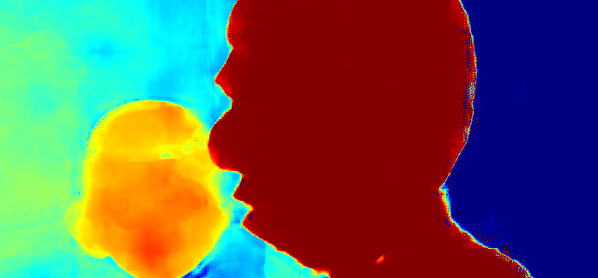
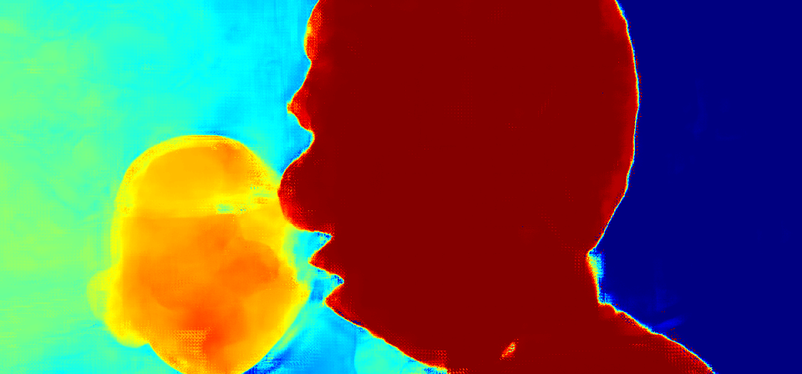
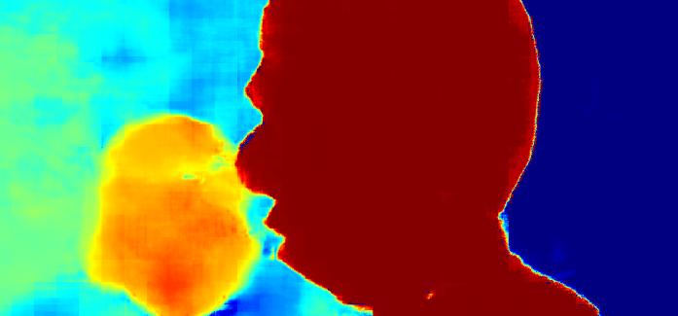

Results on Validation set
Method | L1 loss per image | L1 loss per pxl | output_loss/ input_loss
input validation data | 2008442 | 4.670 | 1
JF_ReluL1 output | 5460072 | 12.695 | 2.72
JF_relu_adaptive output | 3236990 | 7.526 | 1.61
JF_ELU_L1 output | 3005474 | 6.988 | 1.50
JF_ELU_Adaptive loss output | 4070635 | 9.465 | 2.03
FDKN_All layer train adaptive loss output | 1606170 | 3.735 | 0.80
FDKN_only last 2 layers adaptive loss output | 2009825 | 4.673 | 1.00
FDKN_only last 2 layers L1 loss output | 2007699 | 4.668 | 1.00
FDKN_All layer train L1 loss output | 1643387 | 3.821 | 0.82
Input
GT
RELU
L1 Loss
ELU
L1 Loss
FDKN Adaptive Loss
FDKN L1 Loss
FDKN L1 loss only last 2 layers
FDKN Adaptive loss only last 2 layers

Slide 22
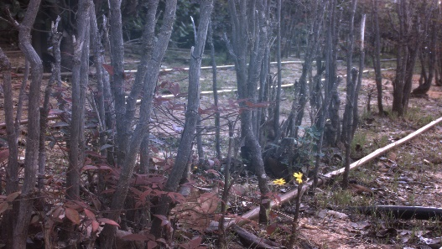
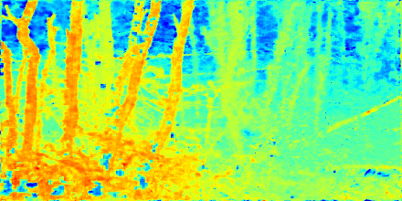
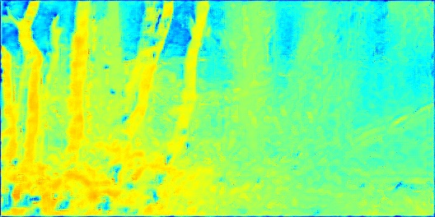
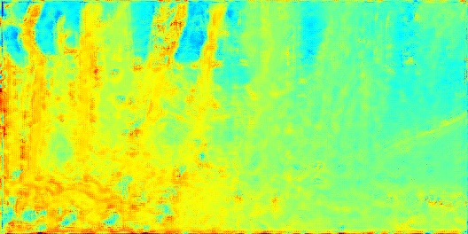
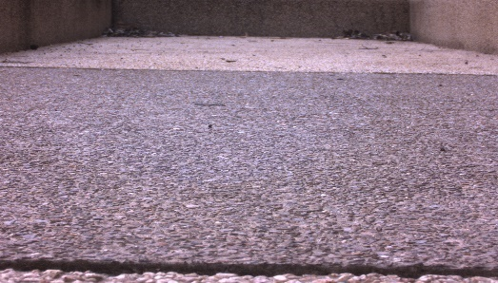
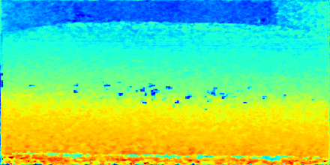
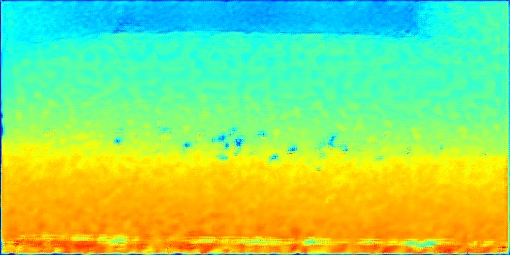
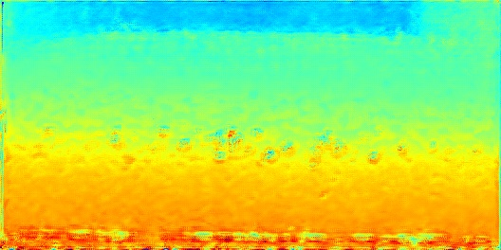
Results on Real World data set
RGB image
DEPTH image input
FDKN L1 Loss
FDKN ADAPTIVE Loss

Slide 23
Main understandings and remarks
Content aware filters (such as FDKN) have potential to improve result in many DNN (segmentation, depth, saliency…)
The field of adaptive losses isn’t researched enough, and has high probability to reach high impact
The domain gap between synthetic data set to real world needs to be approached from initial stages (from planning till execution)

